Slide 1
What Is Disaster Recovery (DR) ?
What is a disaster ?
Any significant event that causes disruption of information technology processing facilities, thus affecting the operations of the business
https://www.sans.org/reading-room/whitepapers/recovery/disaster-recovery-plan-strategies-processes-564

Slide 2
What Is Disaster Recovery (DR) ?
What is disaster recovery (DR) ?
DR is an area of security that allows an organization to maintain or quickly resume mission-critical (IT) functions following a disaster
http://searchdisasterrecovery.techtarget.com/ definition/disaster-recovery

Slide 3
What Is Disaster Recovery (DR) ?
What could cause the invocation of a DR failover to DR site ?
Natural disasters such as flood, earthquake, lightning, storm
Disaster caused by human actions such as riot, fire, terrorist act, etc

Slide 4
What Is Disaster Recovery (DR) ?
What is the difference between DR and business continuity (BC)?
DR is an IT function, whereas business continuity addresses keeping all essential aspects of a business functioning despite disruptive events (DR is a part of BC)
https://en.wikipedia.org/wiki/Disaster_recovery

Slide 5
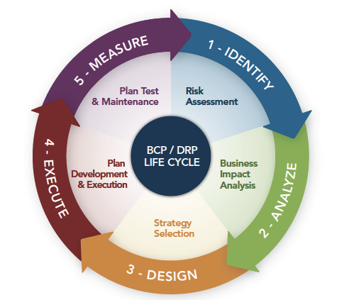
What Is Disaster Recovery (DR) ?
http://grcbizassurance.com/services/disaster-recovery/

Slide 6
What Is Disaster Recovery (DR) ?
Three step process:
Failover to the DR site (DR invocation)
Restoration of the services/facilities on primary site
Recovery (switchover back to primary site)
https://www.sans.org/reading-room/whitepapers/recovery/disaster-recovery-plan-strategies-processes-564

Slide 7
What Is Disaster Recovery (DR) ?
What is a DR plan ?
A documented, structured approach to dealing with unplanned incidents
http://searchdisasterrecovery.techtarget.com/definition/disaster-recovery-plan

Slide 8
What Is Disaster Recovery (DR) ?
DR plan checklist:
Scope of the activity
Gathering relevant network infrastructure documents
Identifying the most serious threats and vulnerabilities, and the most critical assets
http://searchdisasterrecovery.techtarget.com/definition/disaster-recovery-plan

Slide 9
What Is Disaster Recovery (DR) ?
Identifying current DR strategies
Identifying emergency response team
Management review & approval of DR plan
Testing the plan (drill)
Updating the plan
Implementing a DR plan audit
http://searchdisasterrecovery.techtarget.com/definition/disaster-recovery-plan

Slide 10
What Is Disaster Recovery (DR) ?
Sample DR plan template:
http://www.it.miami.edu/_assets/pdf/security/ITPol_A135-Disaster%20Recovery%20Plan%20Example%202.pdf

